Slide 1
Factor analysis: PCFA

Slide 2
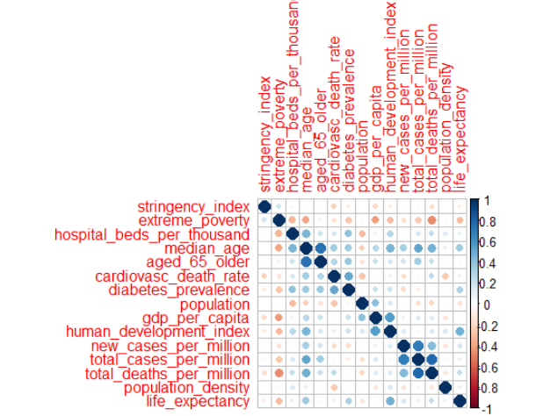
Variable correlation

Slide 3
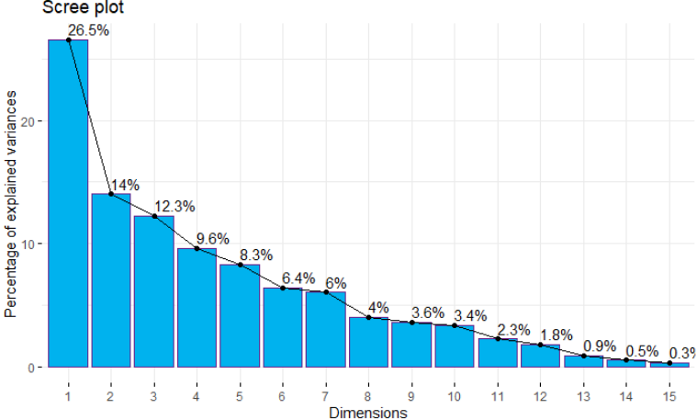
Variance explained

Slide 4
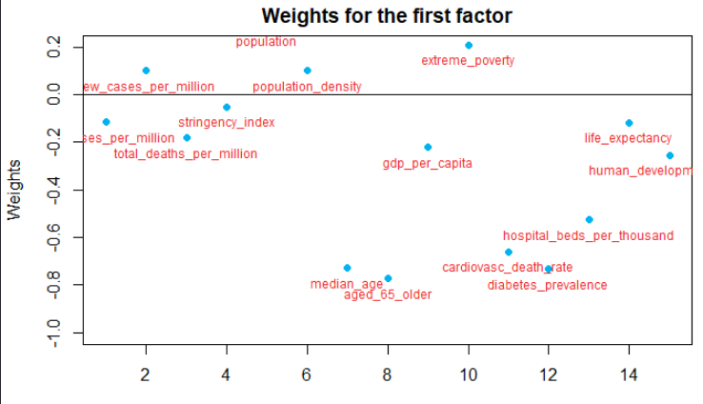
First factor weights

Slide 5
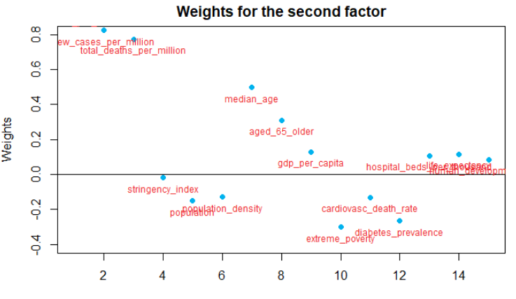
Weights for second factor

Slide 6
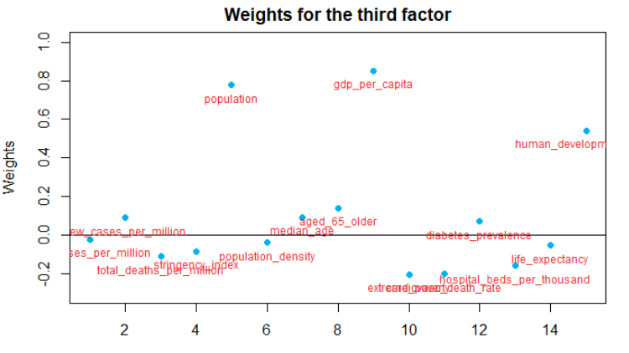
Weights for third factor

Slide 7
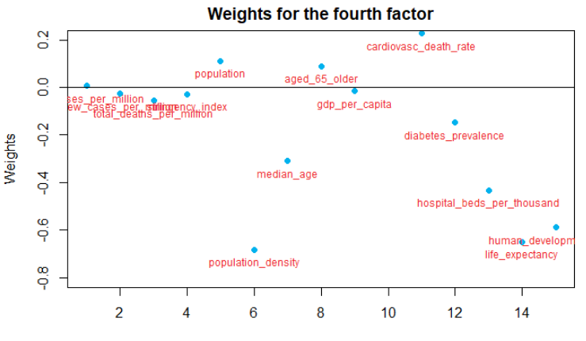
Weights for fourth factor

Slide 8
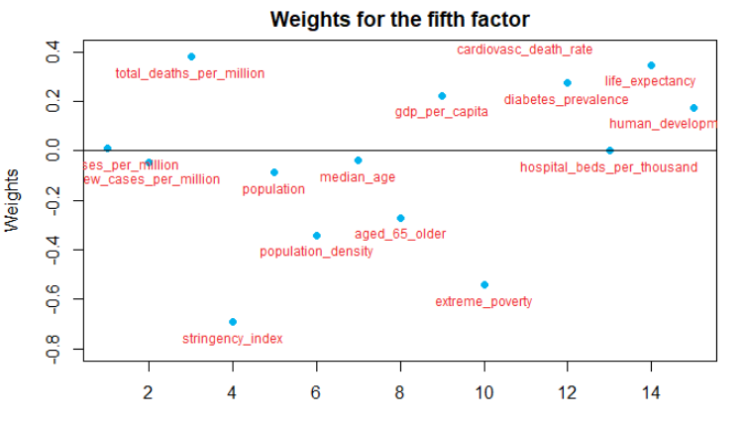
Weights for fifth factor

Slide 9
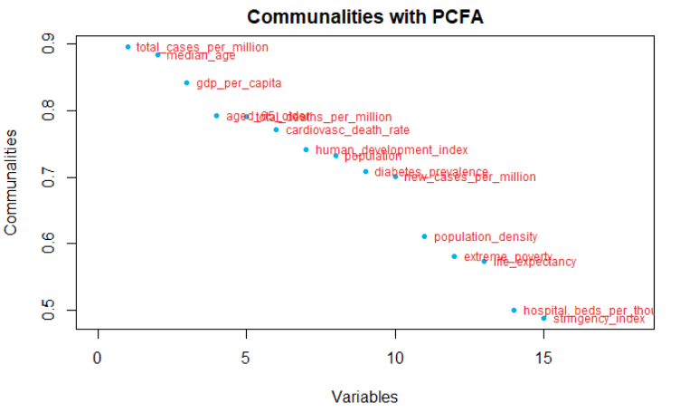
Communalities

Slide 10
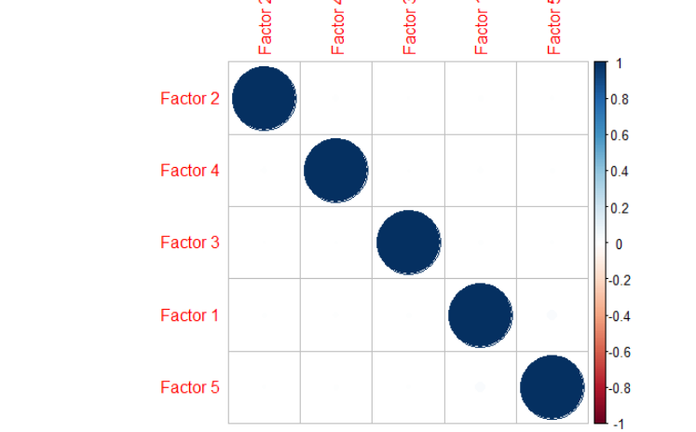
Factor correlation

Slide 11
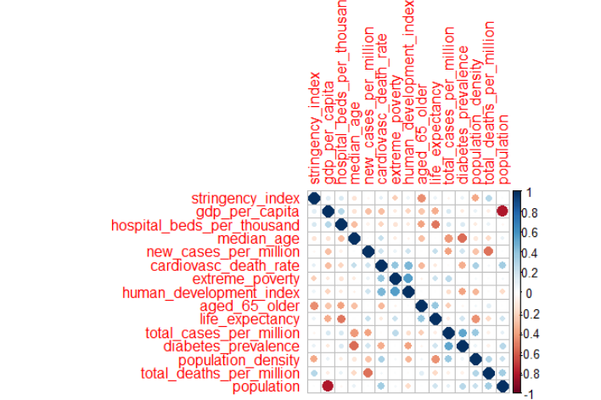
Residuals correlation

Slide 12
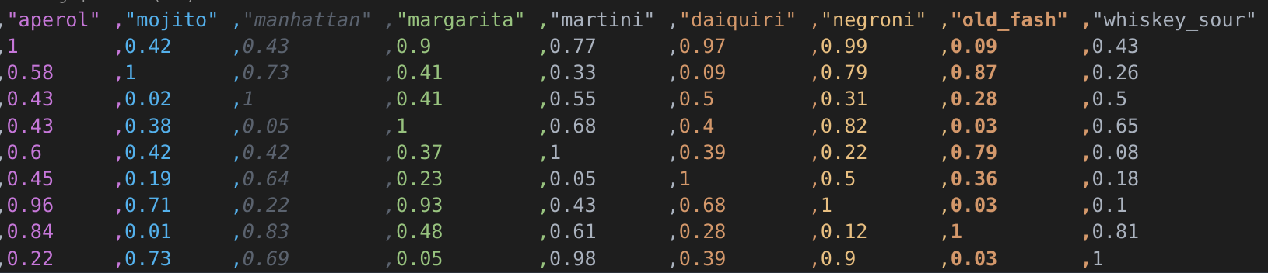
Multidimensional scaling: dataset

Slide 13
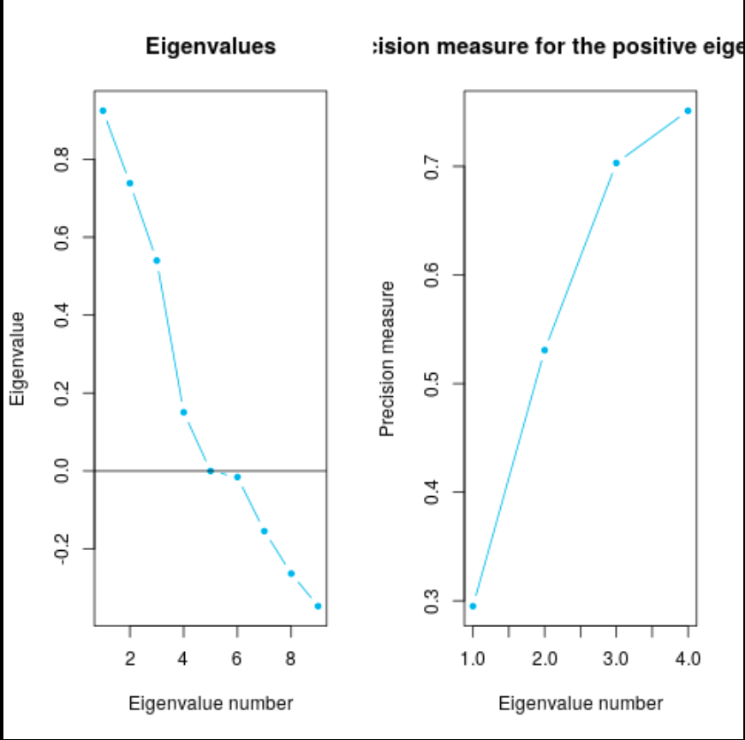
Multidimensional Scaling: Eigenvalues

Slide 14
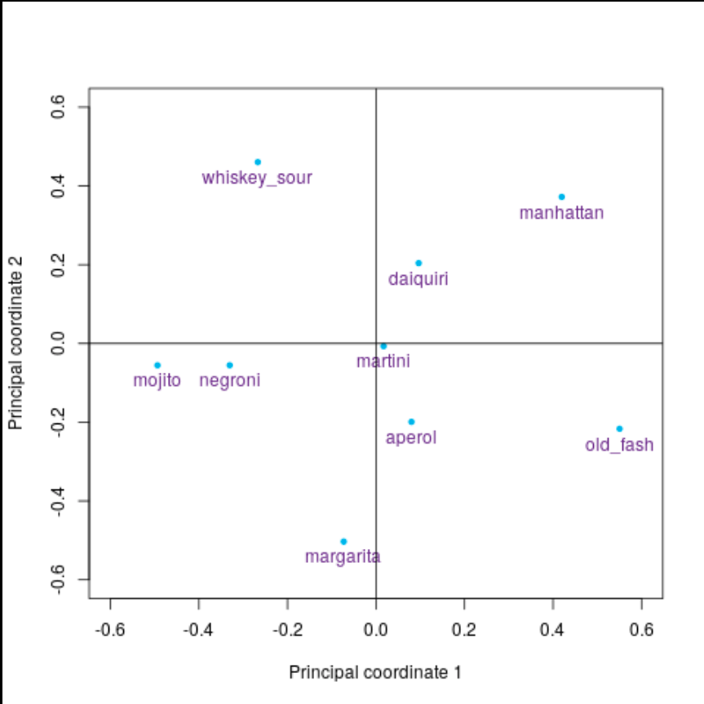
MS: Plotting 2 principal coordinates

Slide 15
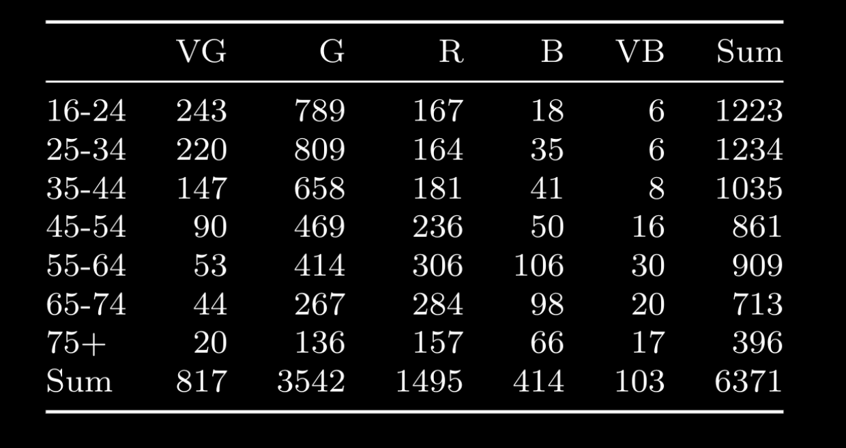
Correspondence Analysis: dataset

Slide 16
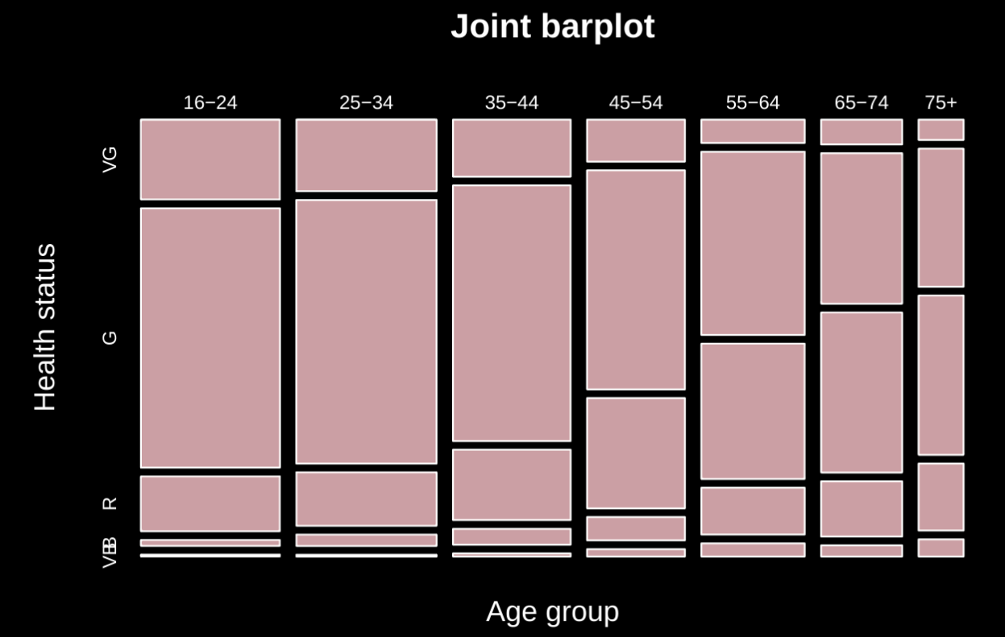
CA: Age group vs Health status joint barplot

Slide 17
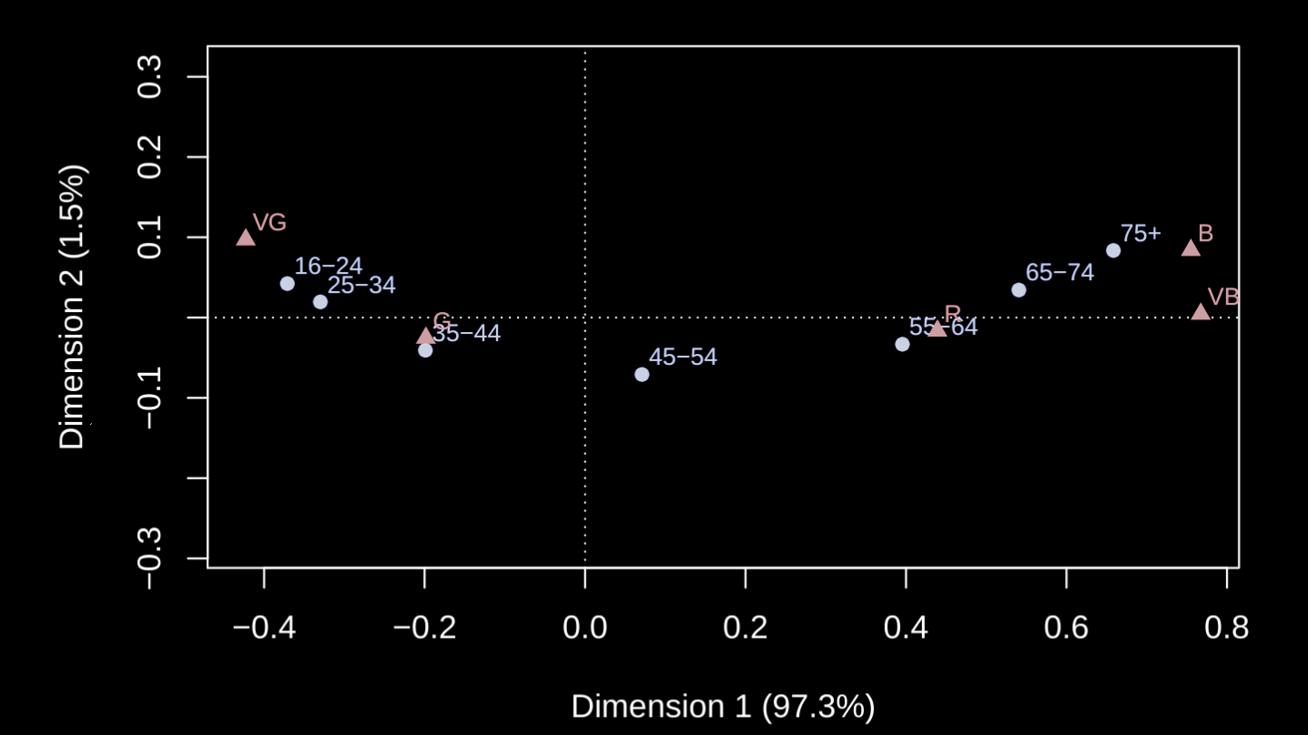
Correspondence analysis results

